Slide 1
CAPSTONE PROJECT
Power Bi
Classic Models
Data Analysis & Visualization
FEBRUARY 17, 2024
SUBMITTED BY: BHAVESH MEWARA
SUBMITTED TO: ODINSCHOOL

Slide 2
Agenda
Problem Briefing
Data Cleaning & Transformation
Tour to the Dashboards
Insights

Slide 3
1. Problem Briefing
A small company Axon, which is a retailer selling classic cars, is facing issues in managing and analyzing their sales data. The sales team is struggling to make sense of the data and they do not have a centralized system to manage and analyze the data. The management is unable to get accurate and up-to-date sales reports, which is affecting the decision-making process.
To address this issue, the company has decided to implement a Business Intelligence (BI) tool that can help them manage and analyze their sales data effectively. They have shortlisted Microsoft Power BI and SQL as the BI tools for this project.
The goal of the capstone project is to design and implement a BI solution using Power BI and SQL that can help the company manage and analyze their sales data effectively.
"I've been tasked with analyzing the Classic Models dataset to address the mentioned challenge. Through this analysis, I've crafted various Power BI dashboards aimed at assisting the organization in making informed decisions. These dashboards provide valuable insights that empower the organization's decision-making process.

Slide 4
2. Data Cleaning & Transformation
A. Customers Table :
Merged Columns: contact first name and Contact Last name columns To Full Name
addressLine2 :- Filled NULL values with N/A
state : filled NULL values with N/A
Postal Code : Filled NULL values with N/A.
Sales Rep Employee Number : Filled NULL with 0.
Sales Rep Employee Number : Changed datatype from float to whole number.
B. Employees Table:
Merged Columns: First name and Last name columns To Name
Office Code : changed datatype from text to int.
Reports To : Filled NULL with 0.
Reports To: Changed datatype from float to int.

Slide 5
C. Office Table:
Office Code : Changed Datatype from string to int
addressLine2 : Filled NULL with N/A
state: Filled NULL with N/A
territory: Filled NULL with N/A
D. Order Details:
Order Line Number : Changed Datatype to int.
E. Order Table:
comments: Removed field as it was unnecessary
F. Create Date Table
G. Product Lines Table:
Html Description: Removed field as it was unnecessary.
Image : Removed field as it was unnecessary.

Slide 6

3. Tour to the Dashboards
CUSTOMERS DASHBOARD
Cards giving detail about customers
(Repeated Customers)
(Total Customers)
(Customers Placed Orders)

Slide 7
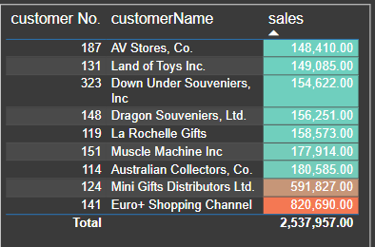
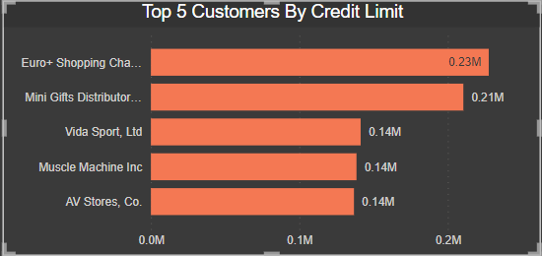
(Customers Wise Sales Table)
(Customers Credit Limit)

Slide 8
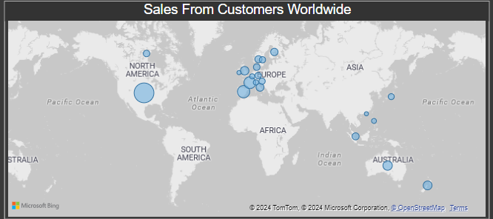
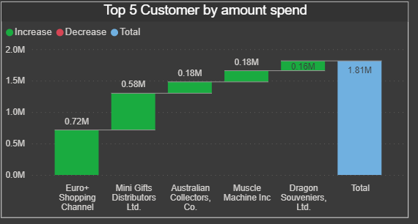
(Customers Worldwide Sales)
(Customers who Spend Max. Amount)

Slide 9
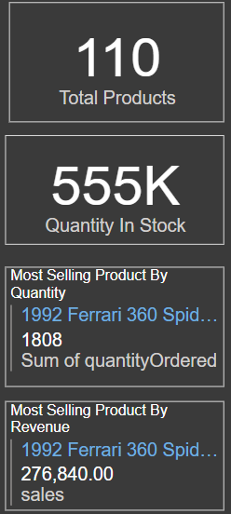

PRODUCT DASHBOARD
(Total Product)
(Product Line Slicer)
(Product Quantity in Stock)
(Most Selling Product By Quantity)
(Year Slicer)
Most Selling Product By Revenue)

Slide 10
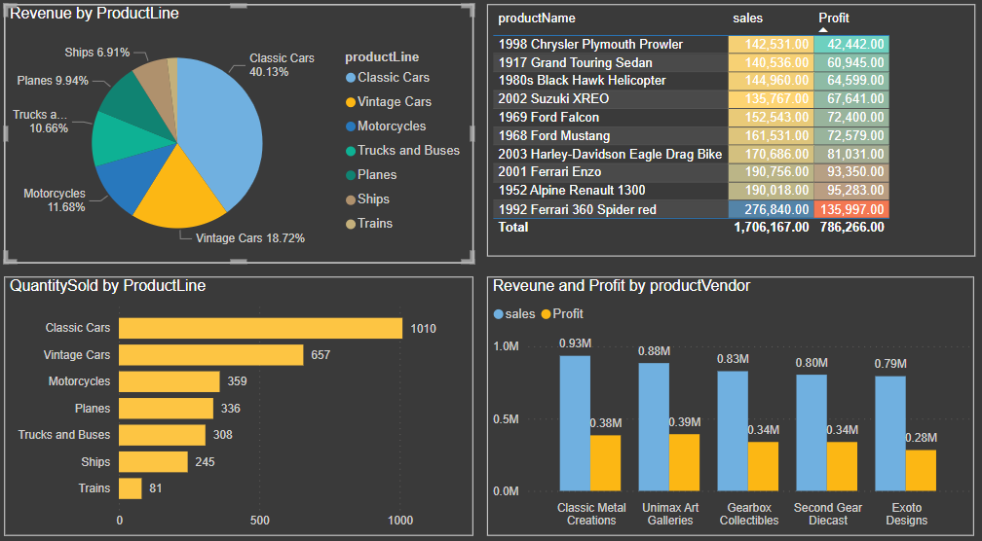
(Sales by Product line)
(Sales and Profit By Product)
(Product line Quantity Sold)
(Sales & Profit By Vendor)

Slide 11
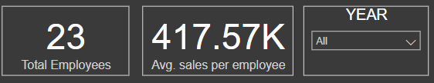
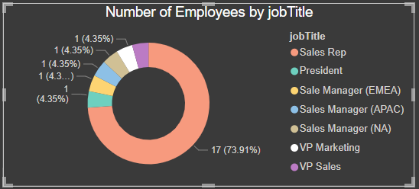
EMPLOYEE DASHBOARD
(Year Slicer)
(Total Employees)
(Avg Revenue Generated by each employee)
(Employees in Job Title)

Slide 12
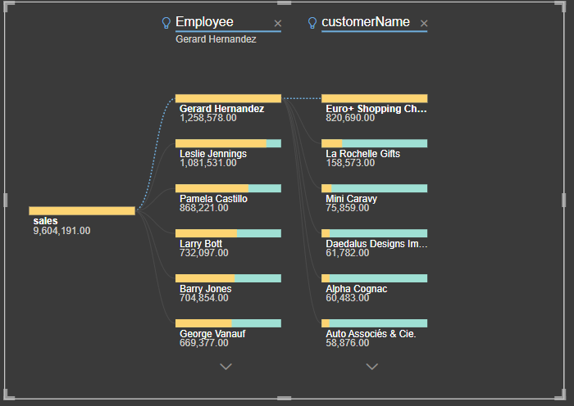
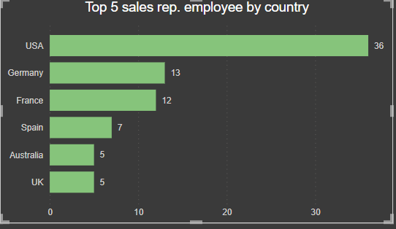
REVENUE GENERATE BY EMPLOYEE FROM CUSTOMER
Country with Maximum Employee

Slide 13
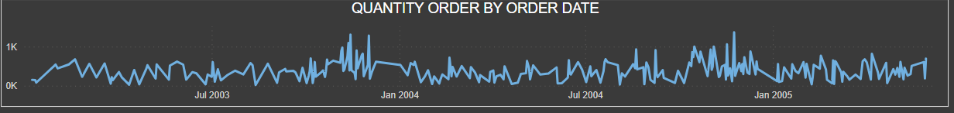
ORDERS AND PAYMENTS DASHBOARD
(Total Orders)
(Avg. Qty per Order)
Avg. Profit per Order
(Quantity Sold)
(Avg. Amt per Order)
(Quantity Order By Date)

Slide 14
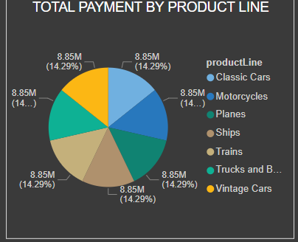
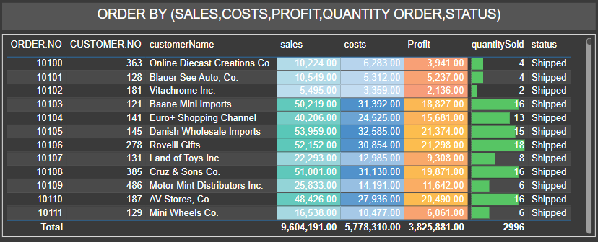
(Payment By Product Line)
(Orders Detail)

Slide 15


SALES DASHBOARD
(State Slicer)
(Country Slicer)
(Product Slicer)
(Year Slicer)
(Total Profit)
(Total Qty Sold)
(Total Employees)
(Total Sales)
(Customers Placed Orders)

Slide 16
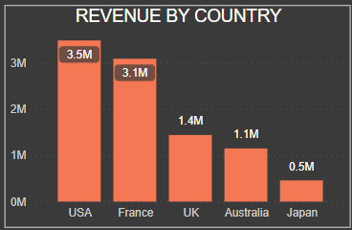
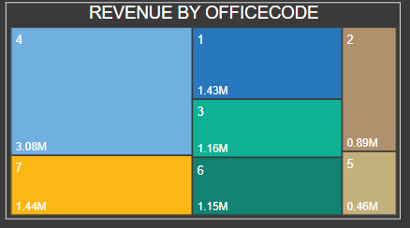
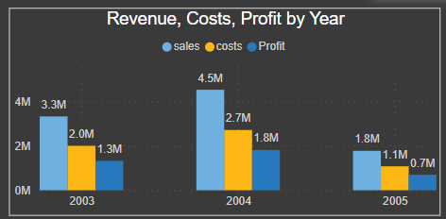
(Total Sales By Country)
(Total Sales by Office Code)
(Year wise sales & Profit)

Slide 17
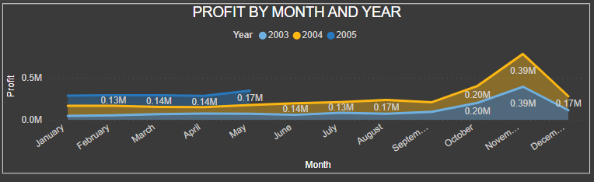
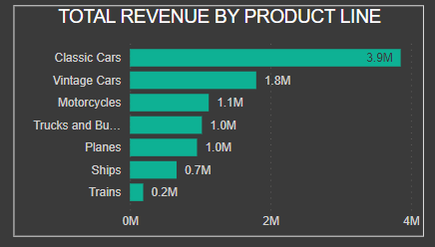
(Year & Monthly Wise Profit)
(Product Line Wise Sales)

Slide 18
4. Insights
* Customers Dashboard *
In this dashboard, very top we have card, which shows how many total customers we have and among them how many customers have placed the orders, how many customers are repeated.
Coming down, we have 4 different chart
Top 5 Customers by Credit Limit:
Euro Shopping Channel has the highest credit limit, followed by Mini Gift and Vida Sports.
Sales From Customers Worldwide:
North America leads in sales, followed by Spain and France.
Top 5 Customers by Amount Spent:
Euro Shopping Channel tops the list for the highest amount spent, followed by Mini Gift.
Top 10 Customers Based on Sales (Table):
Display the table showcasing the top 10 customers ranked by sales

Slide 19
* Products Dashboard *
Product Overview:
The dashboard displays a total of 110 products available.
Inventory Status:
The quantity in stock card provides an overview of the current inventory.
Most Selling Product by Quantity:
The 1990 Ferrari 360 Spider (Red) stands out as the most sold product by quantity.
Most Selling Product by Revenue:
The Ferrari 360 is identified as the top revenue-generating product.
Revenue by Product Line:
Classic Cars contribute the maximum revenue, emphasizing their popularity among customers.
Vintage Cars and Motorcycles also play significant roles in revenue generation.
Quantity Sold by Product Line:
Classic Cars lead in the quantity sold, indicating strong customer demand.
Vintage Cars and Motorcycles follow in terms of quantity sold.
Top 10 Products:
The table showcases the top 10 products based on their combined sales and profit, providing insights into high-performing items.
Revenue and Profit by Product Vendor:
Classic Metal Creations emerge as the vendor with the highest revenue and profit.
Uni max Art Galleries also demonstrate strong performance in revenue and profit.

Slide 20
* Employees Dashboard *
Workforce Overview:
The organization employs a total of 23 individuals.
Sales Performance:
On average, each employee contributes $417.57k in sales, highlighting the effectiveness of the sales team.
Job Title Distribution:
The donut chart illustrates the distribution of employees across different job titles.
Sales Representatives dominate the workforce, followed by the President and Sales Manager.
Sales Representatives by Country:
The cluster chart identifies the top 5 sales representatives based on their country of operation.
The USA has the highest number of top-performing sales representatives, followed by Germany and France.
Top Sales Contributors:
The decomposition tree chart reveals the employees making the maximum sales contributions.
Gerard Hernandez leads in sales, followed by Leslie Jennings and Pamela Castillo.
Overall, this dashboard offers valuable insights into workforce dynamics, sales performance, and the geographical distribution of top-performing sales representatives. It provides a holistic view for strategic decision-making and workforce management.

Slide 21
* ORDERS AND PAYMENTS Dashboard *
Order Overview:
A total of 3,726 orders have been processed.
The quantity sold is 2,996, with an average of 324 units per order.
The average amount per order is $29.46k, and the average profit per order is $11.75k.
Product Line Payments:
The pie chart illustrates the distribution of total payments across different product lines.
It provides a quick visual understanding of which product lines contribute most to the overall revenue.
Order Breakdown:
The bar chart breaks down order details, showcasing sales, cost, profit, quantity, and order status.
This helps identify trends, understand cost structures, and monitor the status of orders.
Quantity Ordered Over Time:
The line chart depicts the quantity ordered on specific dates.
It allows for tracking trends and identifying peak periods, aiding in inventory management and operational planning.

Slide 22
* SALES Dashboard *
Sales Overview:
The dashboard provides a comprehensive view of sales data, allowing for analysis based on product lines, years, states, and countries.
Yearly Performance:
In 2004, there is a peak in revenue, cost, and profit compared to 2003 and 2005, indicating a particularly successful year.
Profit Distribution by Month:
The chart reveals that November 2004 had the highest profit, followed by 2005 and 2003. Understanding monthly patterns helps in strategic planning.
Key Metrics:
Profit generated is $3,615.75k, showcasing the financial success of the business.
Revenue amounts to $9,060.49k, indicating a substantial income.
A total of 2,996 quantities were sold, representing the volume of goods moved.
98 customers placed orders, reflecting the customer base, and the workforce consists of 23 employees.
Revenue by Product Line:
Classic Cars lead in generating revenue, emphasizing their popularity.
Vintage Cars and Motorcycles also contribute significantly to overall revenue.
Revenue by Office Code:
Office Code 4 stands out with the maximum revenue, followed by 7 and 1. This insight can guide resource allocation and focus.
Revenue by Country:
The USA generates the highest revenue, indicating a strong market presence.
France and the UK also contribute substantially to the overall revenue.
.

